Slide 1
선형회귀 (Linear Models for Regression)
Yahoo! Research
강창성
cskang@yahoo.com

Slide 2
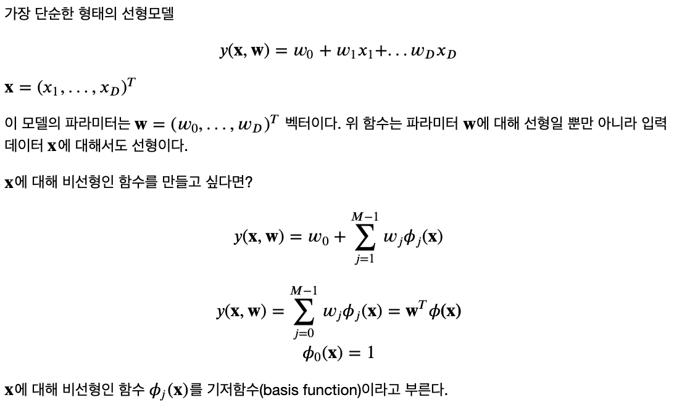
선형 기저 함수 모델
선형회귀 (Linear Models for Regression)

Slide 3
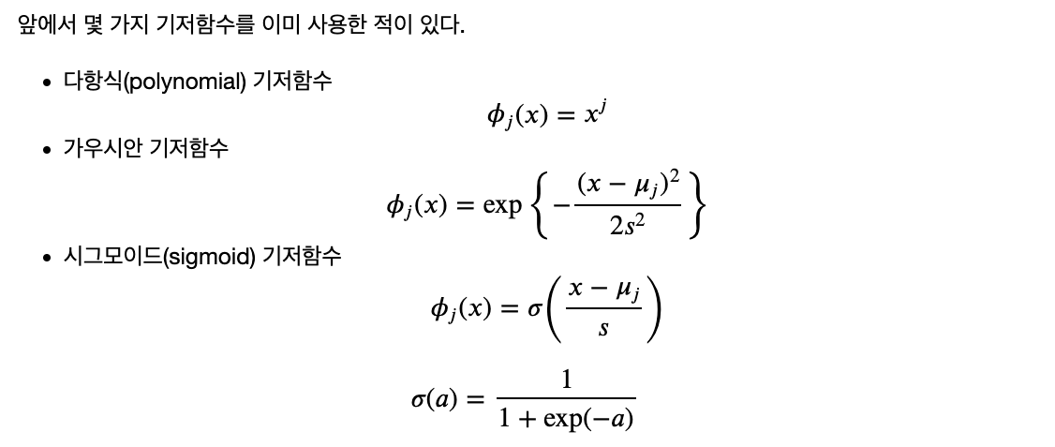
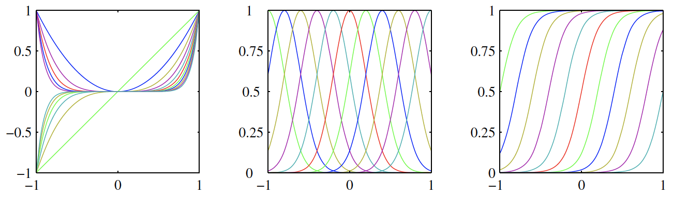
선형 기저 함수 모델
선형회귀 (Linear Models for Regression)

Slide 4
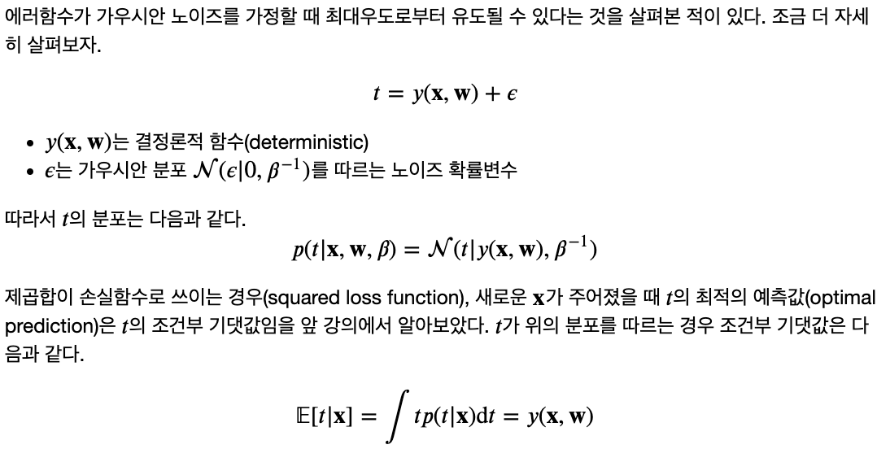
최대우도와 최소제곱법 (Maximum Likelihood and Least Squares)
선형회귀 (Linear Models for Regression)

Slide 5
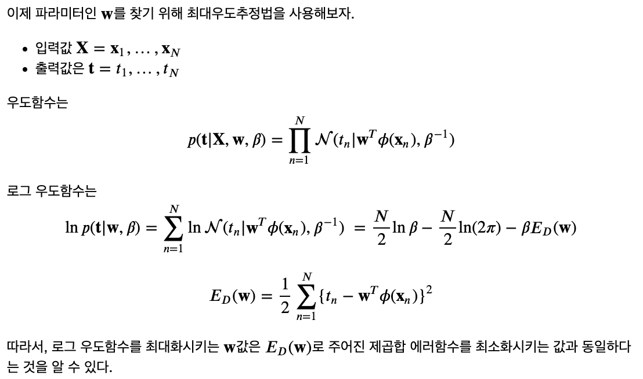
최대우도와 최소제곱법 (Maximum Likelihood and Least Squares)
선형회귀 (Linear Models for Regression)

Slide 6
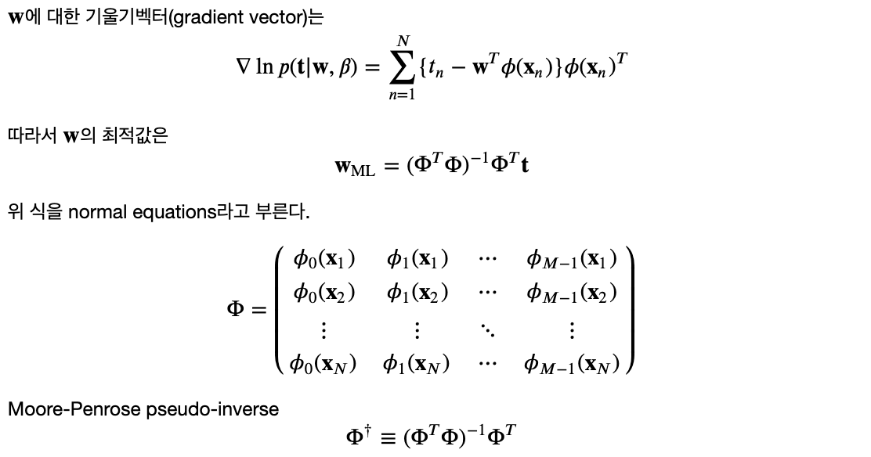
최대우도와 최소제곱법 (Maximum Likelihood and Least Squares)
선형회귀 (Linear Models for Regression)

Slide 7
최대우도와 최소제곱법 (Maximum Likelihood and Least Squares)
선형회귀 (Linear Models for Regression)
Normal equations 유도하기

Slide 8
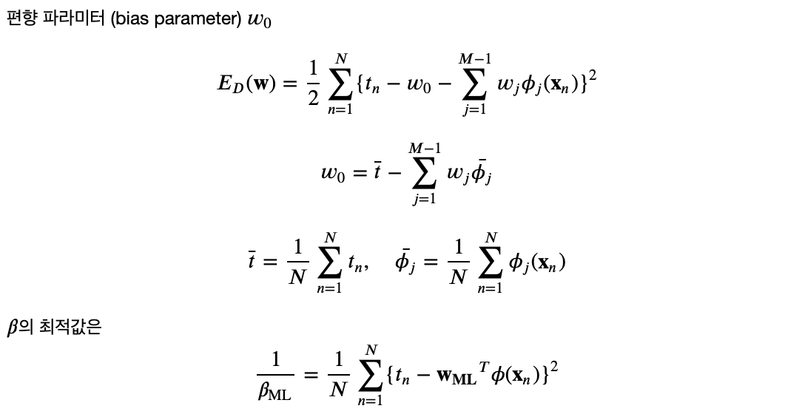
최대우도와 최소제곱법 (Maximum Likelihood and Least Squares)
선형회귀 (Linear Models for Regression)

Slide 9
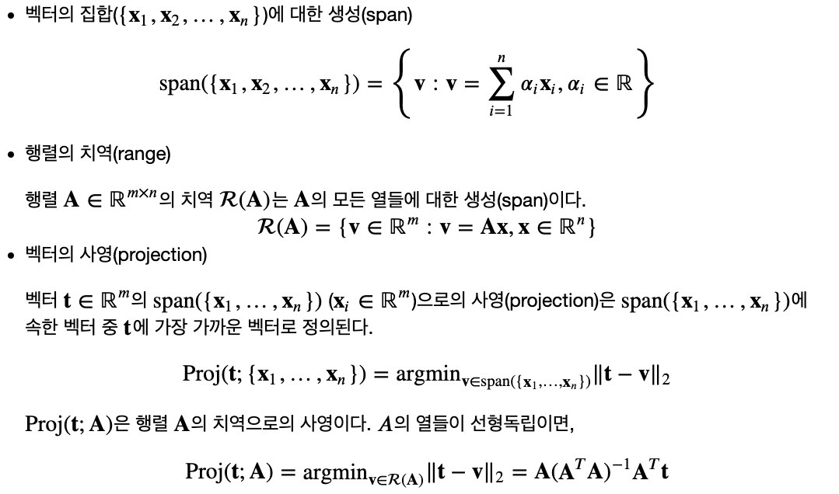
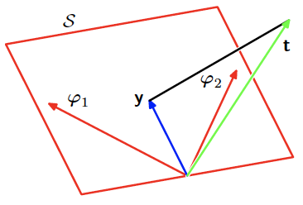
기하학적 의미
선형회귀 (Linear Models for Regression)

Slide 10
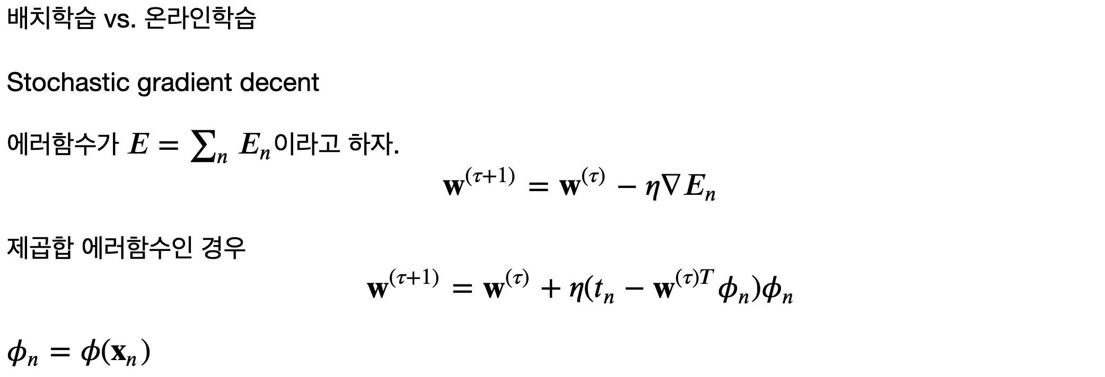
온라인 학습 (Sequential Learning)
선형회귀 (Linear Models for Regression)

Slide 11
실습 (대규모의 선형회귀)
선형회귀 (Linear Models for Regression)

Slide 12
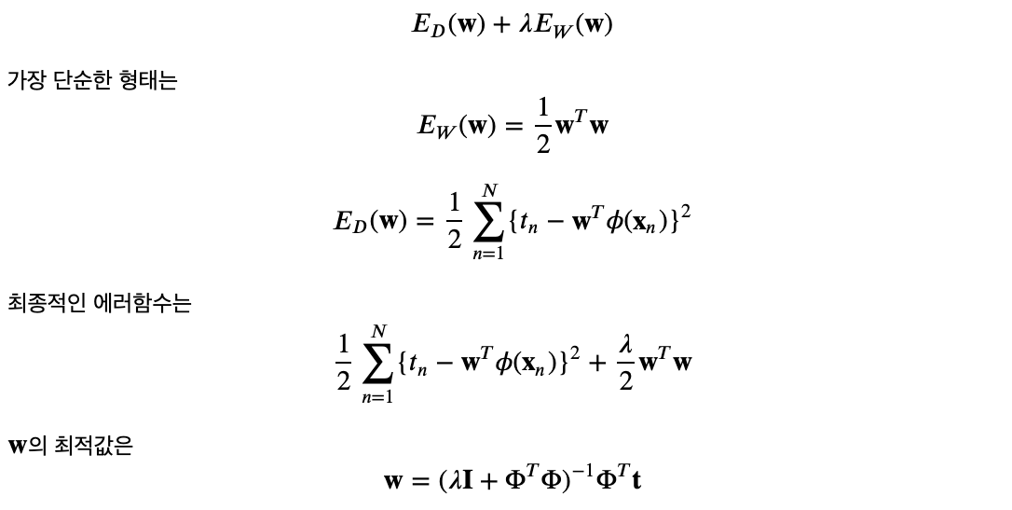
규제화된 최소제곱법 (Regularized Least Squares)
선형회귀 (Linear Models for Regression)

Slide 13
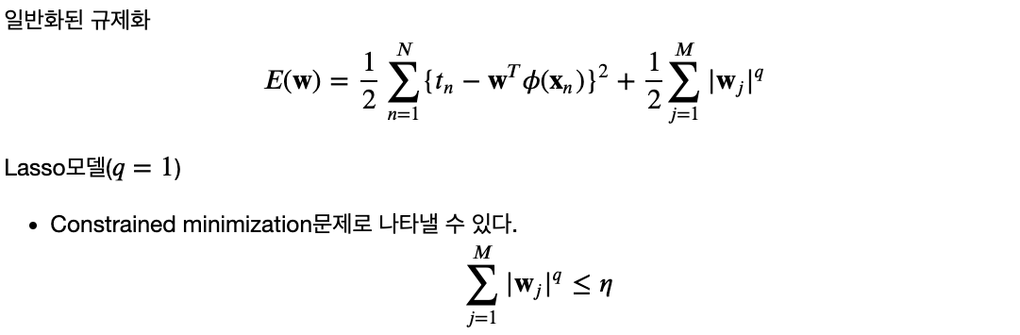
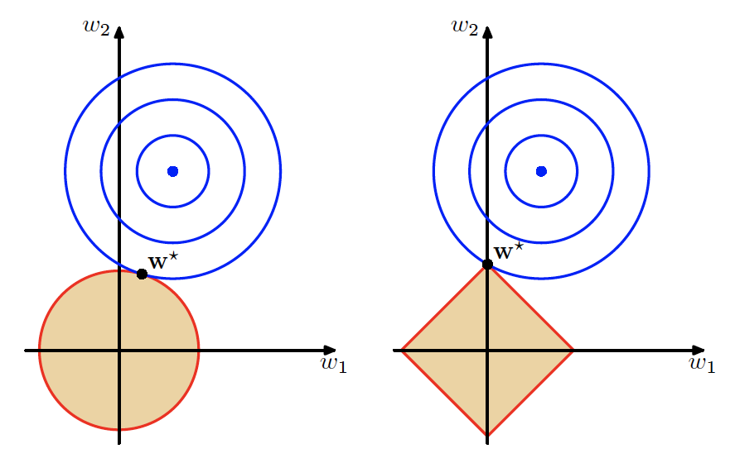
규제화된 최소제곱법 (Regularized Least Squares)
선형회귀 (Linear Models for Regression)

Slide 14
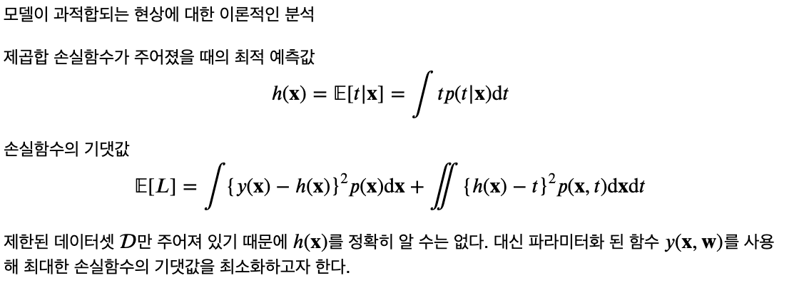
편향-분산 분해 (Bias-Variance Decomposition)
선형회귀 (Linear Models for Regression)

Slide 15
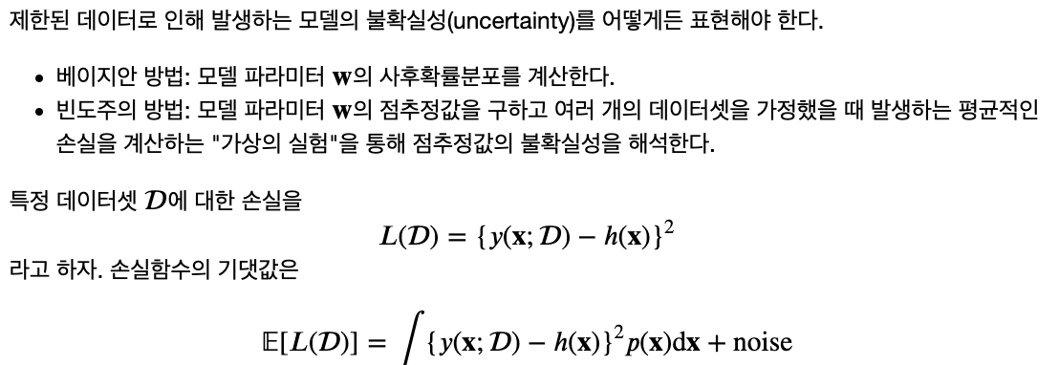
편향-분산 분해 (Bias-Variance Decomposition)
선형회귀 (Linear Models for Regression)

Slide 16
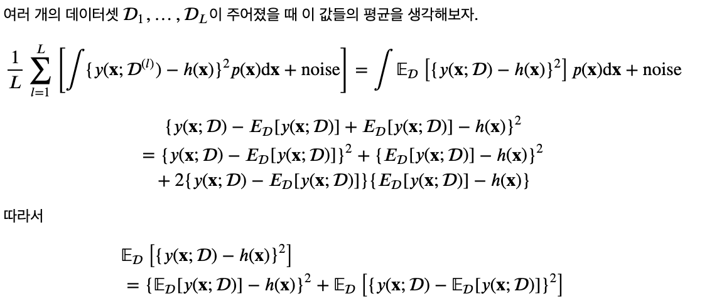
편향-분산 분해 (Bias-Variance Decomposition)
선형회귀 (Linear Models for Regression)

Slide 17
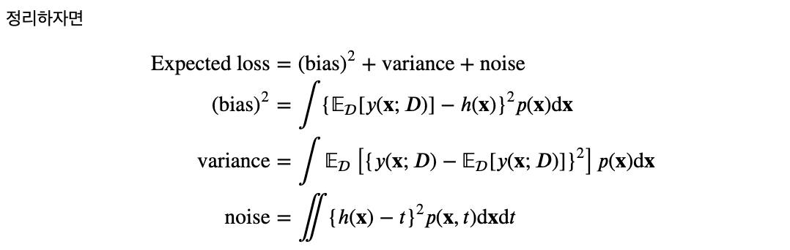
편향-분산 분해 (Bias-Variance Decomposition)
선형회귀 (Linear Models for Regression)

Slide 18
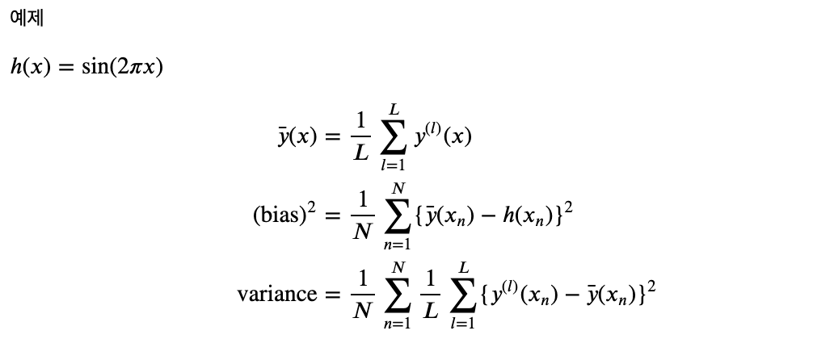
편향-분산 분해 (Bias-Variance Decomposition)
선형회귀 (Linear Models for Regression)

Slide 19
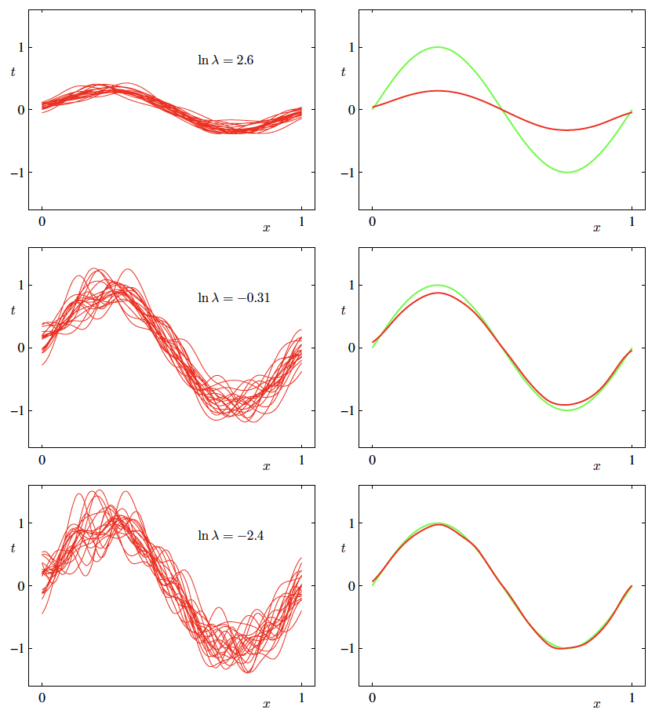
편향-분산 분해 (Bias-Variance Decomposition)
선형회귀 (Linear Models for Regression)

Slide 20
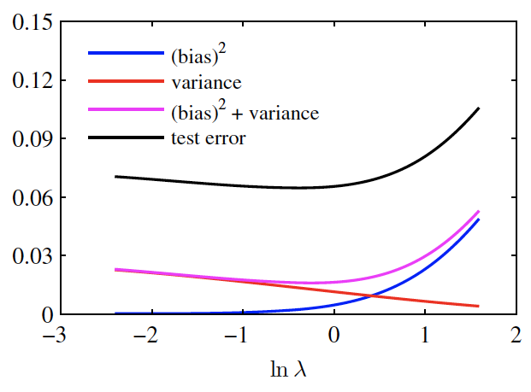
편향-분산 분해 (Bias-Variance Decomposition)
선형회귀 (Linear Models for Regression)
별개의 테스트 데이터셋에 대한 결과

Slide 21

베이지안 선형회귀 (Bayesian Linear Regression)
선형회귀 (Linear Models for Regression)

Slide 22
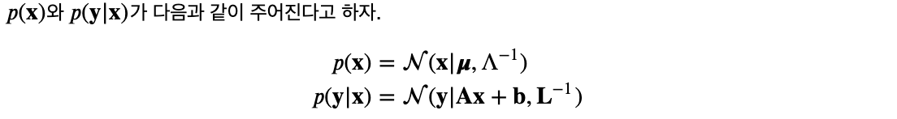

베이지안 선형회귀 (Bayesian Linear Regression)
선형회귀 (Linear Models for Regression)
복습 (가우시안 분포를 위한 베이즈 정리)

Slide 23
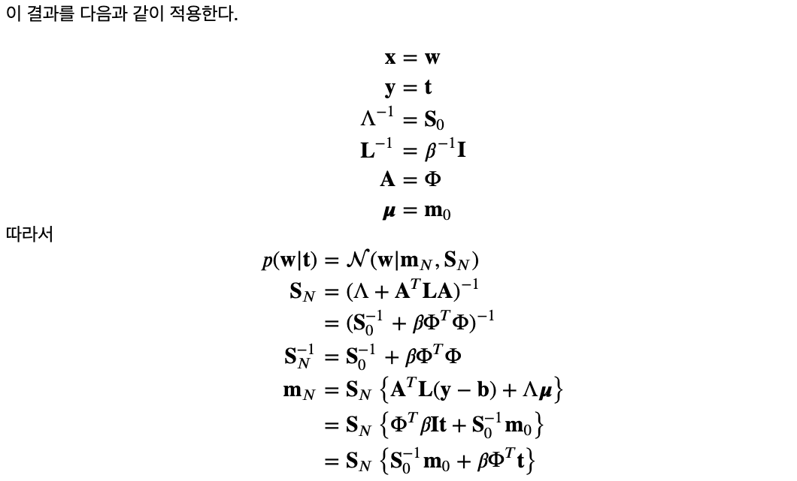
베이지안 선형회귀 (Bayesian Linear Regression)
선형회귀 (Linear Models for Regression)

Slide 24
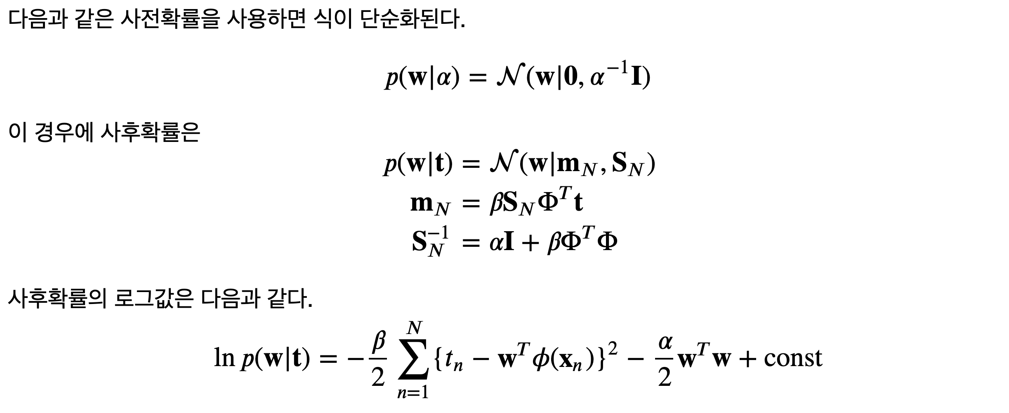
베이지안 선형회귀 (Bayesian Linear Regression)
선형회귀 (Linear Models for Regression)

Slide 25
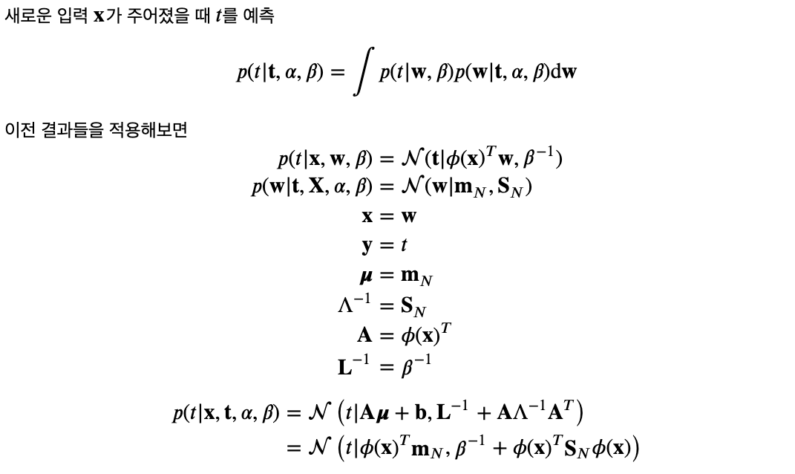
베이지안 선형회귀 (Bayesian Linear Regression)
선형회귀 (Linear Models for Regression)
예측분포 (Predictive Distribution)

Slide 26
감사합니다!
Yahoo! Research
강창성
cskang@yahoo.com

